Slide 1


HTML Test Preparation
http://telerikacademy.com
HTML5
Telerik Software Academy
http://academy.telerik.com

Slide 2

Random Questions

Slide 3
Question
Which one of the following is not capable of generating HTML:
JavaScript
Human
Web server
CSS

Slide 4
Question
What is the purpose of the <noframes> tag:
Specify an area without frames
Provide a functionality for browsers, that do not support HTML5
Provide a fallback for browsers, that do not support frames
Disable the effect of the <frameset> tag

Slide 5
Question
Which of the following methods will result in this URL after form submit?
get
post
put
delete
http://en.wikipedia.bg/h/index.php?title=Main_page&action=row

Slide 6
Question
What is the purpose of <input type="hidden">
The same as input type text, but only for secret data
For secret fields, used by web administrators
Send data to the server, invisible for the regular user
It is used for secure input of passwords

Slide 7
Question
What is the purpose of the iframe?
Show one web page before another
Provide navigation inside a frame
Rendering a Quick Player inside a web page
Show one web page inside another

Slide 8
Question
What is the difference between <b> and <strong>?
There is no difference
<strong> marks the text as "stronger" than the other, while <b> bolds it only visually
The <strong> tag comes in HTML5, while the <b> tag is deprecated
The <b> tag bolds the text, while the <strong> tag makes the text with bigger font size

Slide 9

Web Technologies Basics

Slide 10
Question
We have the following User-Agent string:
What is the operating system?
Microsoft Windows 7 – 32-bit
Ubuntu Linux – 64 bit
Microsoft Windows 7 – 64-bit
Apple iOS
Apple Mac OS X
Microsoft Windows 8 – 32-bit
Microsoft Windows XP – 32 or 64-bit
Mozilla/5.0 (Windows NT 6.1; WOW64) AppleWebKit/537.1 (KHTML, like Gecko) Chrome/21.0.1180.89 Safari/537.1

Slide 11

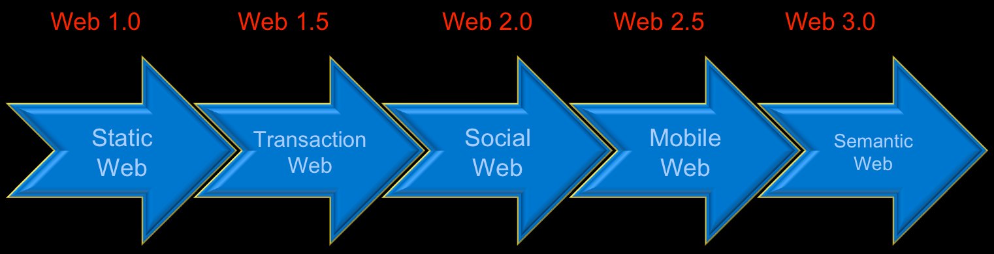
Question
Who is the main content creator in Web 3.0?
A team of highly trained monkeys
Computers (Artificial Intelligence)
Users
Developers
Professional authors
The government

Slide 12
Question
A web page consists of:
A set of HTML5 documents
A HTML file + corresponding CSS file
A HTML file + optional additional resources (images, styles, scripts, etc.)
A text document written in HTML language + images and other assets (optionally)
A single HTML file
A web server hosting HTML files, CSS styles and images
A HTML file hosted somewhere in the cloud

Slide 13

HTML Fundamentals

Slide 14

Question
What does HTML stand for?
Hyperlinks and Text Markup Language
Hyper Text Markup Language
Home Tool Markup Language
Hyperlinks Tool Markup Language

Slide 15

Question
What are attributes?
Properties of the HTML Elements
The smallest piece of HTML
Combination of opening and closing tags

Slide 16

Question
The value of the attributes is surrounded by:
;
“ ” or ‘ ’
" " or ``
“ ’ or ‘ ”
“ ‘
" " or ' '
" ” or ' '

Slide 17

Question
Which of the following tags is used for the largest heading:
<h6>
<head>
<heading>
<header>
<h1>

Slide 18

Question
Which of the following tags is used for inserting a line break?
<br />
<break />
<lb />
<nl>
<\n>

Slide 19
Question
What is the correct way for creating a hyperlink?
<a url=" http://telerikacademy.com "> Telerik Academy</a>
<a href="http://telerikacademy.com"> Telerik Academy</a>
<a>http://telerikacademy.com</a>
<a name="http://telerikacademy.com"> Telerik Academy</a>

Slide 20
Question
What is the correct way for creating an e-mail link?
<email href="academy@telerik.com">
<email>academy@telerik.com</email>
<a href="mailto:academy@telerik.com">
<a href="academy@telerik.com">
<mailto href="academy@telerik.com">

Slide 21

Question
What is the correct way for making a checkbox?
<input type="check" />
<check>
<checkbox>
<input type="checkbox" />

Slide 22

Question
Which is of the following is the tag for making a text area?
<input type="textbox" />
<input type="textarea" />
<textarea>
<input type="multiline" />

Slide 23

Question
Which of the code line is a valid HTML and will display a textbox field?
<textfield>
<textinput type="text" />
<text></text>
<input />

Slide 24
Question
What is the correct way for inserting an image?
<image src="image.gif" alt="TelerikAcademy" />
<img alt=" TelerikAcademy">image.gif</img>
<img href="image.gif" alt=" TelerikAcademy" />
<img src="image.gif" alt="TelerikAcademy" />

Slide 25
Question
What we gain, when we write valid HTML code?
This is the only way for the code to be understandable to other developers
The browser will not understand invalid HTML
The browser renders valid HTML a bit faster than invalid
CSS styles works only on valid HTML
It is cooler to be valid!

Slide 26

Answer
The <!DOCTYPE> tag tells the web browser about what version of HTML to use
The browser handles the page accordingly to its Doctype declaration
HTML 5 Doctype:
<!DOCTYPE html>

Slide 27
Question
Image tags should have either their width or their height set (or both). Why is that?
When lower than the actual height/width is given, the browser downloads a smaller image file
The browser should know the space for the image, to load the other content below/near it
When width/height is not set, the images is with default width and height 0, and it does not show

Slide 28

Answer
When height and width are set
The space required for the image is reserved when the page is loaded
Before the image is loaded
Without these attributes, the browser does not know the size of the image
And cannot reserve the appropriate space
After image loading the page is updated (unpleasant effect)

Slide 29

Question
How do you comment out HTML markup?
<-Telerik Academy->
<-- Telerik Academy -->
<!-- Telerik Academy --!>
<!-- Telerik Academy -->
< Telerik Academy />
//Telerik Academy
/* Telerik Academy */
# Telerik Academy #

Slide 30

Question
Which of the following is the correct use of the <title> tag?
<title="Telerik Academy"></title>
<title="Telerik Academy" />
<title text="Telerik Academy" />
<title content="Telerik Academy" />
<title>Telerik Academy</title>

Slide 31

Question
Which of the following tags is most important for the search engines?
Heading 1 – <h1>
Header – <header>
Paragraph – <p>
All of above

Slide 32

Question
The <title> tag:
Displays a title for the page in search-engine results
The <h1> tag – primary heading of a document
Used by search engines
Include only one per page in XHTML 1.1
Many <h1> in HTML5

Slide 33

Question
What are <div> tags used for?
To replace paragraphs. i.e. <p>
To logically divide the paragraphs
To logically divide the document
To provide space between tables
To group similar elements

Slide 34
Answer
The HTML <div> tag is used for defining a section of your document
You can group large sections of HTML elements together with <div>
And format them with CSS
<div style="text-align:center">
<p>Navigation section</p>
</div>
<div style="border:1px solid black">
<p>Content section</p>
</div>

Slide 35

Question
HTML elements are combination of:
Tags and IDs
Attributes and classes
Tag and classes
Tags and attributes
Classes and names

Slide 36
Question
The HTML element <html> is:
Used to mark the beginning and middle of a HTML document
Used to mark the beginning and ending of a HTML document
Used to mark the beginning of a HTML document
Used to mark the HTML body
Used to mark the HTML header

Slide 37
Answer
<!DOCTYPE html>
<html>
<head>
<title>
…
</title>
</head>
<body>
…
</body>
</html>
An HTML element starts with a start tag / opening tag
An HTML element ends with an end tag / closing tag
The element content is everything between the start and the end tag
Some HTML elements have empty content

Slide 38

Question
HTML <body> element should contains:
All the visible to the user markup
All the invisible to the user markup
Resources
Attributes
Scripts and data
Only text data

Slide 39
Answer
<!DOCTYPE html>
<html>
<head>
<title>
…
</title>
</head>
<body>
<!-- Content -->
</body>
</html>
The <body> tag defines the document's body
The <body> element contains all the contents of an HTML document
Text, hyperlinks, images, tables, lists, etc.

Slide 40
Question
Which of the following are block elements?
<div>, <p>
<span>, <p>
<a>, <div>
<em>, <h1>
<h1>, <ul>
1,2,3
2,3,4
3,4,5
1,5
3,4
4,5

Slide 41
Answer
Block level elements normally start (and end) with a new line when displayed in a browser
Examples: <h1>, <p>, <ul>, <table>, <div>
Have rectangular form (rectangular block)
Inline elements are normally displayed without starting a new line
Examples: <b>, <td>, <a>, <img>, <span>
Parts of paragraphs (e.g. a piece of text)
May have non-rectangular form

Slide 42

Question
Which of the following tags can be used to make a list of numbered items?
<ul></ul>
<ol></ol>
<nl></nl>
<dl></dl>
<list></list>
<numbered></numbered>

Slide 43

Question
What tag is used to create a definition list?
<dt></dt>
<dd></dd>
<dl></dl>
<di></di>
<dl><di>

Slide 44

Tables

Slide 45
Question
Which of these tags are related to the <table> tag?
<ttable>
<head>
<body>
<tfoot>
<tr>
<th>
<tt>
<tf>
1, 2, 4
2, 3, 4
4, 5, 6
5, 6, 7
5, 6, 8
1, 5, 6
2, 4, 6

Slide 46
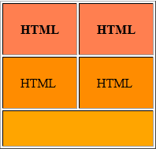
Question
Which of the following code blocks will visualize the table:
To be continued…

Slide 47
Question
<table cellpadding="22" border="1">
<tr><th>HTML</th><th>HTML</th></tr>
<tr><td>HTML</td><td>HTML</td></tr>
<tr><td colspan="2"></td></tr>
</table>
<table cellpadding="22" border="1">
<tr><td>HTML</td><td>HTML</td></tr>
<tr><td>HTML</td><td>HTML</td></tr>
<tr><td colspan="2"></td></tr>
</table>
<table cellpadding="22" border="1">
<tr><th>HTML</th><th>HTML</th></tr>
<tr><th>HTML</th><th>HTML</th></tr>
<tr><td colspan="2"></td></tr>
</table>
<table cellpadding="22" border="1">
<tr><th>HTML</th><td>HTML</td></tr>
<tr><td>HTML</td><td>HTML</td></tr>
<tr><td colspan="2"></td></tr>
</table>

Slide 48
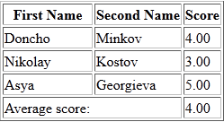
Question
Which of the following tags is the best to be placed in the missing position:
<tfood>
<tablefoot>
<footer>
<tfooter>
<tfoot>
None of the above
To be continued…

Slide 49
Question
<table border="1">
<colgroup><col style="width:100px" /><col/></colgroup>
<thead>
<tr>
<th>First Name</th>
<th>Second Name</th>
<th>Score</th>
</tr>
</thead>
<…>
<tr><td colspan="2">Average score:</td><td>4.00</td></tr>
</…>
<tbody>
<tr><td>Doncho</td><td>Minkov</td><td>4.00</td></tr>
<tr><td>Nikolay</td><td>Kostov</td><td>3.00</td></tr>
<tr><td>Asya</td><td>Georgieva</td><td>5.00</td></tr>
</tbody>
</table>

Slide 50
Question Cont.
Which of the following tags is the best to be placed in the missing position:
<tfood>
<tablefoot>
<footer>
<tfooter>
<tfoot>
None of the above

Slide 51

Question
What table attribute is used in the picture?
cellspacing = "15" and cellpadding = "0"
cellpadding = "15" and cellspacing = "15"
cellspacing = "0" and cellpadding = "15"
cellmargin
cellpadding
margin
padding
None of the above

Slide 52
Question
Is this code valid?
<!DOCTYPE html>
<html>
<head><title>Telerik Academy</title></head>
<body>
<h1>Telerik Academy</h1>
<li>Home</li>
<li>Software Academy</li>
<li>Courses</li>
<li>BG coder</li>
<li>About</li>
</body>
</html>
To be continued…

Slide 53




Question
Is this code valid?
Yes, it is
No, it isn’t

Slide 54
Answer
<!DOCTYPE html>
<html>
<head><title>Telerik Academy</title></head>
<body>
<h1>Telerik Academy</h1>
<ul>
<li>Home</li>
<li>Software Academy</li>
<li>Courses</li>
<li>BG coder</li>
<li>About</li>
</ul>
</body>
</html>
The <ul> tag together with the <li> tag creates an unordered list
<li> cannot be used outside of <ul> or <ol>

Slide 55
Question
What is wrong with the following code?
<!DOCTYPE html4>
<html>
<head>
<title>Example</title>
</head>
<body>
<div id="my-div">
<div id="sub-div">
<h1>Section 1</h1>
<p>Content paragraph</p>
<p>Here's another content article</p>
</div>
To be continued…

Slide 56
Question
<div>
<h1>Section 2</h1>
<p>Content paragraph</p>
<p>Here's another content article</p>
</div>
<table cellpadding="22">
<tr>
<th>Telerik</th>
<th>Academy</th>
</tr>
<tr>
<td colspan="2"></td>
</tr>
</table>
</div>
</body>
</html>
To be continued…

Slide 57

Question
What is wrong with the following code?
The Doctype should have more attributes
The Doctype should be <!DOCTYPE html5>
The Doctype should be <!DOCTYPE html>
The Ids must be the same
No errors

Slide 58
Question
What is wrong with the following code?
<table cellpadding="15" border="1">
<tr>
<td valign="top">1</td>
<td>
<table class="main-table" cellpadding="15" border="1">
<tr><td>2</td>
<td>
<table class="main-table" cellpadding="15" border="1">
<tr><td>4<td><td>5</td></tr>
</table>
</td>
</tr>
</table>
</td>
</tr>
</table>
To be continued…

Slide 59

Question
There are duplicated classes
There is a tag, which is not closed
There is a tag, which is not opened
There is no such attribute like “valign”
There is no such attribute like “valign” with value “top” (valign="top")

Slide 60
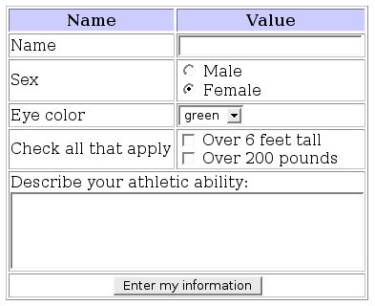
Forms

Slide 61

Question
What does the "action" attribute tells in the form tag?
How the form data should be sent
Where the form data should be sent
Whose form data should be sent
Which of the form data should be sent

Slide 62
Question
What does the "method" attribute tells in the form tag?
Where the form data should be sent
Whose the form data should be sent
How the form data should be sent
What the form data should be sent

Slide 63
Question
What is wrong with the following code?
<h1>Telerik Academy</h1>
<div>
<img src="image.png" />
<h2>HTML course</h2>
<h3>C# course</h3>
<span>Students</span>
<br>
<span>Age</span>
</br>
</div>
The </br> tag
The <img> tag
The <h1> tag
The src attribute

Slide 64

Question
What is the best way to insert an input element that is not shown on the page?
<input type="…" name="Account" value="This is your Account" />
hidden
invisible
secret
private
cover

Slide 65
Question
Which of the following tags is the most appropriate for the missing position:
<!DOCTYPE html>
<html>
<head><title></title></head>
<body>
<form method="post" action="form.aspx">
<…>
<legend>Personal Information</legend>
<input type="text" id="Name" />
<input type="text" id="Email" />
</…>
</form>
</body>
</html>
fieldset
textarea
inputset
formset
legendset

Slide 66
Question
Which is the most appropriate tag for the missing position ?
<label for="classes">Countries</label>
<… multiple="multiple" id="classes">
<option value="geo">Bulgaria</option>
<option value="math">Italy</option>
<option value="eng">Spain</option>
</…>
To be continued…

Slide 67

Question
Which is the most appropriate tag for the missing position ?
form
fieldset
legend
selected
select
textarea
<label for="classes">Countries</label>
<… multiple="multiple" id="classes">
<option value="geo">Bulgaria</option>
<option value="math">Italy</option>
<option value="eng">Spain</option>
</…>

Slide 68
Question
Is this code valid?
<!DOCTYPE html>
<html>
<head><title>Example</title></head>
<body>
<h1>Parts</h1>
<ul>
<li>Part 1</li>
<li>Part 2</li>
<li>Part 3
<ul>
<li>Part 3.1</li>
</li>
</ul>
<li>Part 4
<ul><li>4.1</li></ul>
</li>
</ul>
</body>
</html>
To be continued…

Slide 69
Question
Is this code valid?
Yes, it is
No, it isn’t

Slide 70
Answer
<!DOCTYPE html>
<html>
<head><title>Example</title></head>
<body>
<h4>Parts</h4>
<ul>
<li>Part 1</li>
<li>Part 2</li>
<li>Part 3
<ul>
<li>Part 3.1</li>
</ul>
</li>
<li>Part 4
<ul><li>4.1</li></ul>
</li>
</ul>
</body>
</html>

Slide 71

Semantic HTML

Slide 72

Question
What is CSS used for (3 answers):
Define the layout of the elements
Define the presentation of elements
Define the content of a Web page
Handles the request to the Web server
Define style rules

Slide 73

Question
What does the semantic HTML give us:
Improves server performance
More difficult to render by the browsers
A way to show the search engines the correct meaning of the HTML page
Easier to read by machines
More-valid HTML

Slide 74
Question
Which of the following are HTML5 semantic tags for layout?
<nav>, <a>
<section>, <footer>
<span>, <section>
<em>, <header>
<footer>, <p>
<nav>, <header>
<article>, <nav>
1, 2, 3
4, 5, 6
1, 3, 4
5, 6
2, 6, 7
1, 2
4, 6

Slide 75
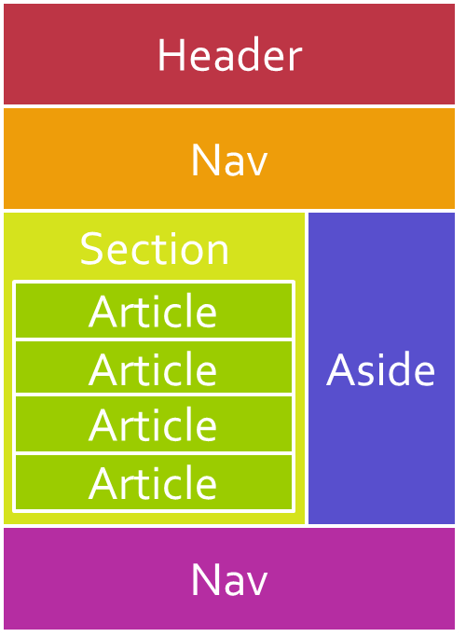
Answer
Some of the new semantic elements in HTML5 are:
<article>, <time>, <figure>, <footer>, <header>, <aside> <section> and <nav>
Used like divs for the page content layout

Slide 76
Question
Which of the following tags is semantically the most appropriate?
<body>
<header>
<h1>Telerik Academy</h1>
<…>
<ul>
<li><a href="#">Home</a></li>
<li><a href="#">Software Academy</a></li>
<li><a href="#">Courses</a></li>
<li><a href="#">Resources</a></li>
</ul>
</…>
</header>
</body>
To be continued…

Slide 77
Question
Which of the following tags is semantically the most appropriate?
<div>
<p>
<headerItem>
<nav>
<section>
<details>
<content>

Slide 78
Answer
Which of the following tags is semantically the most appropriate?
<body>
<header>
<h1>Telerik Academy</h1>
<nav>
<ul>
<li><a href="#">Home</a></li>
<li><a href="#">Software Academy</a></li>
<li><a href="#">Courses</a></li>
<li><a href="#">Resources</a></li>
</ul>
</nav>
</header>
</body>
The <nav> tag defines a section of navigation links

Slide 79
Answer
Combine the text and the tags in the below HTML fragment so that the result is semantically correct markup?
<…>
<…>
<…>C# програмиране - част I</…>
</…>
<p> В безплатния курс "HTML oснови" се изучават основите на уеб програмирането. Разглеждат се начални понятия за уеб, като браузъри, уеб сървъри, системата клиент- сървър, инструменти за разработка, езика HTML и др..
</p> </…>
To be continued…

Slide 80
Question
Combine the text and the tags so that the result is semantically correct markup?
<article>, <header>, <h1>, </h1>, </header>, </article>
<article>, <div>, <span>, </span>, </div>, </article>
<div>, <header>, <span>, </span>, </header>, </div>
<div>, <p>, <h1>, </h1>, </p>, </div>
<div>, <div>, <span>, </span>, </div>, </div>

Slide 81
Answer
Combine the text and the tags so that the result is semantically correct markup?
<article>
<header>
<h1>C# програмиране - част I</h1>
</header>
<p> В безплатния курс "HTML oснови" се изучават основите на уеб програмирането. Разглеждат се начални понятия за уеб, като браузъри, уеб сървъри, системата клиент- сървър, инструменти за разработка, езика HTML и др..
</p> </article>

Slide 82
Question
Combine the text and the tags so that the result is semantically correct markup?
<…>
<…>CSS</…>
<…>Cascading Style Sheets</…>
<…>PHP</…>
<…>PHP:Hypertext Preprocessor</…>
<…>HTML</…>
<…>HyperText Markup Language</…>
</…>
<dd><dt></dt><dl></dl></dd>
<dl><td></td><tr></tr></dl>
<dt><dl></dl><dd></dd></dt>
<dl><dt></dt><dd></dd></dl>

Slide 83
Answer
Combine the text and the tags so that the result is semantically correct markup?
<dl>
<dt>CSS</dt>
<dd>Cascading Style Sheets</dd>
<dt>PHP</dt>
<dd>PHP:Hypertext Preprocessor</dd>
<dt>HTML</dt>
<dd>HyperText Markup Language</dd>
</dl>
A definition list is a list of items, with a description of each item

Slide 84
Sample HTML Test
?
?
?
?
?
Questions?
?
?
?
?
?
http://academy.telerik.com

Slide 85



Free Trainings @ Telerik Academy
"Web Design with HTML5, CSS3 and JavaScript" course @ Telerik Academy
html5course.telerik.com
Telerik Software Academy
academy.telerik.com
Telerik Academy @ Facebook
facebook.com/TelerikAcademy
Telerik Software Academy Forums
forums.academy.telerik.com

